Slide 1
Big Mountain Ski Resort Ticket Price model

Slide 2
Recall Problem
How can Big Mountain Resort increase revenue with rising operating costs of $1540000 this season either by finding areas to cut costs without undermining ticket price or making changes to ticket pricing strategy that fully capitalizes on its facilities?

Slide 3
Recommendation and key findings
Our model suggests that Big Mountain should be increasing its ticket price from given its current facilities. Big Mountain Ski Resort ranks highly in many key features that correlate with ticket prices which gives it strong pricing power. To improve revenue further, management could increase the vertical drop by adding a run to a point 150 feet lower down, install an additional chair lift to bring skiers back up, without additional snow making coverage. Our model predicts that this increases ticket prices by $1.99. If the costs associated with this operation is less than the revenue it brings, then this should theoretically increase Big Mountain’s profits.

Slide 4
Data Modelling Steps
Data Wrangling – removing redundancy in raw data.
Exploratory Data Analysis
Model Preprocessing and feature engineering
Model scenarios

Slide 5
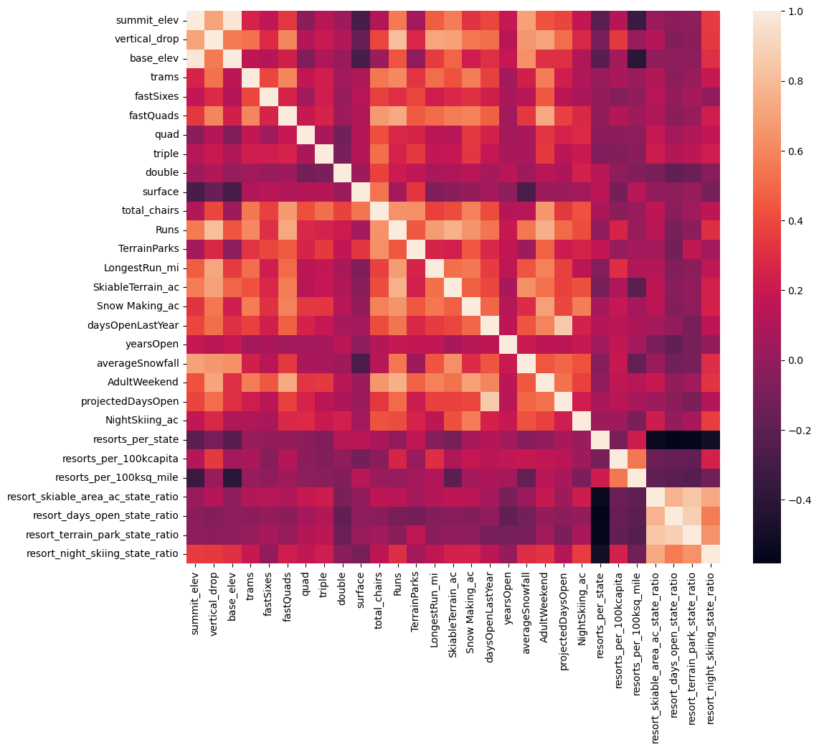
Key Correlations with Ticket Price
In our data wrangling step, the original data set of 330 observations with 27 data features was reduced to 277 observations with 25 data features, of which there are 22 numerical features and 3 categorical data features.
New features were also created to standardize across states for subsequent modelling – resorts_per_100kcapita and resorts_per_100ksq_mile
PCA is performed on all features including the newly created ones and a heat map correlation shown on the right here is produced.
We want to focus on features with high correlation with ‘AdultWeekend’ ticket prices.

Slide 6
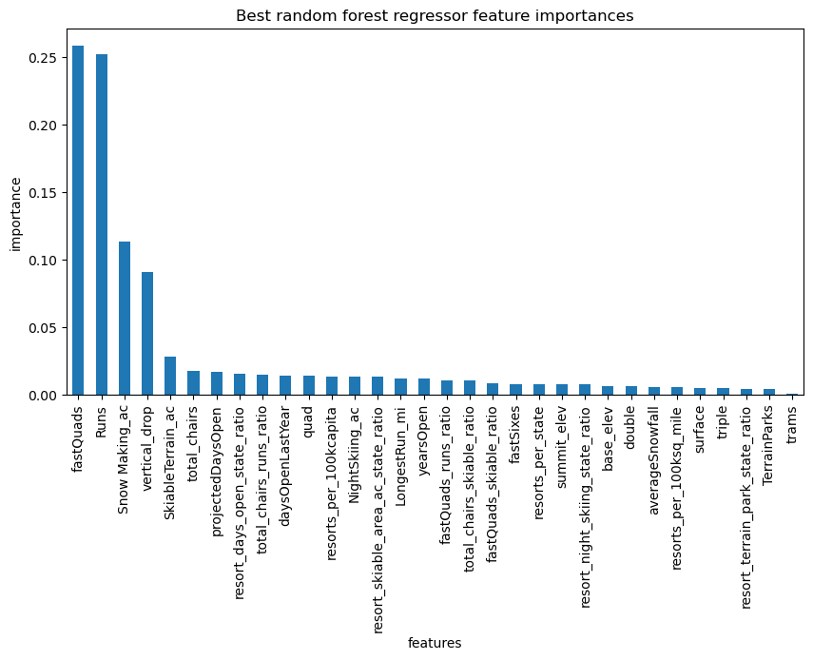
Modelling Results
Random Forest Regressor model is selected here for the best results (least mean squared error and least mean absolute error).
The model returns the most dominant 4 features to be fastQuads, Runs, Snow Making_ac, vertical_drop
Big Mountain currently charges $81. Assuming all other resorts are fairly priced, the model predicts Big Mountain should be charging $95.87 with an error of $10.39, showing room for a ticket price increase.

Slide 7
Conclusion
Big Mountain Resort should immediately increase it’s current ticket price from $81 to improve profitability
In the scenario of adding a run, increasing drop by 150ft and installing a new chair lift, Big Mountain should be able to increase the ticket prices by $1.99. This will create additional revenue of $3474638 per season. If the cost of a new chair lift is lower than the revenue, then this may be a good upfront investment for the business.
The increased revenue from our recommendation covers the increased costs this season and will improve the overall profitability of Big Mountain Resort.

